Slide 1
Good Agriculture is a farm business management platform so small-and-midsize farmers can do more of what they do best: focus on the farm operations.

Slide 2
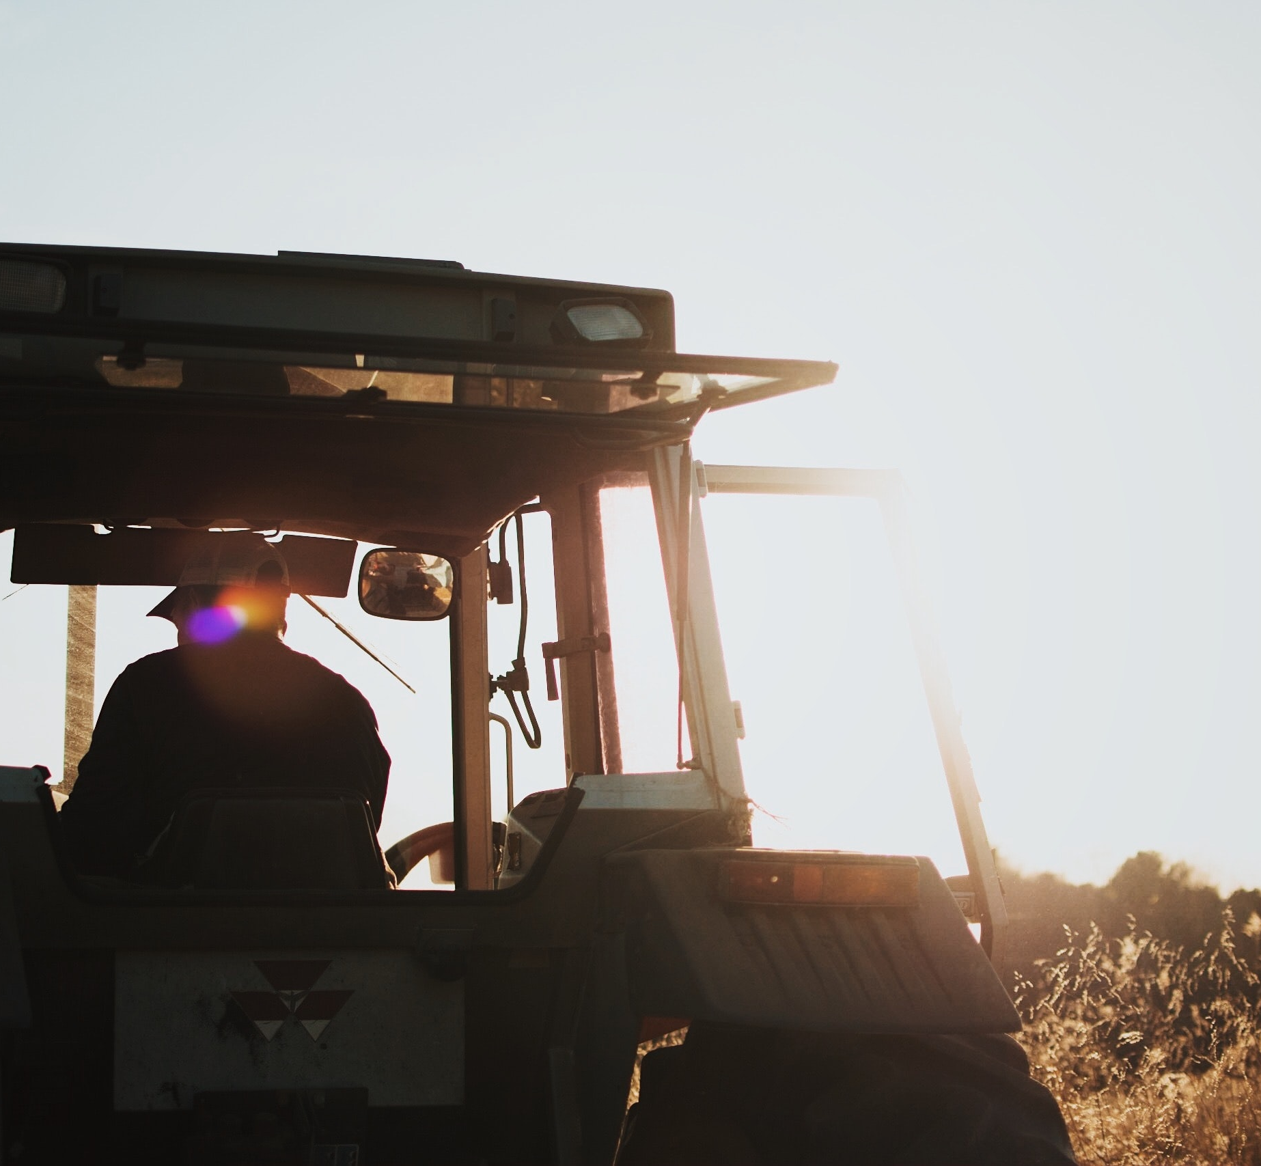
Our farmers are overwhelmed
Most farmers don’t make enough profit to be financially sustainable¹.
Farmers are “one man bands” who do all the farming and business functions themselves, and now they’re also being asked to farm more sustainably.
This means farmers have little time to invest in their operations.
1 USDA ERS for 2021

Slide 3
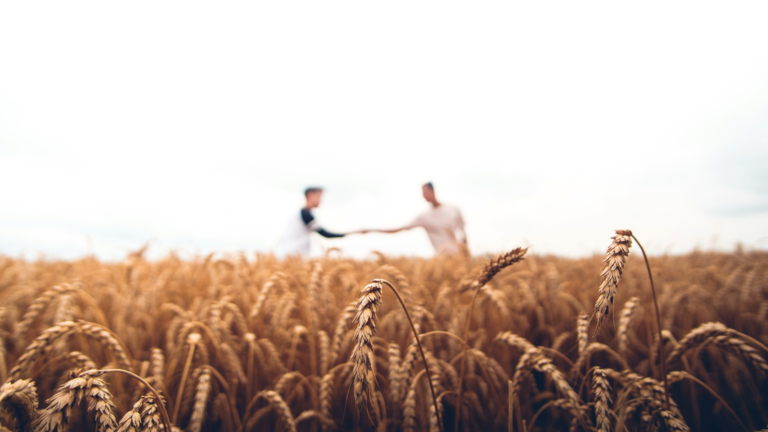
The solution:
Good Agriculture – the scalable corporate back office for farmers

Slide 4









Our AI-powered platform enables farmers to update their operations, get profitable, and grow their farms
Existing
Good Ag tech
Hybrid tech
Integrated best-of-breed solution
Marketing & sales
Carbon tracking
Funding
Financial management
Insurance
Operational analysis
Prototyping with
USDA SBIR grant
Certifications
Inventory
Future state

Slide 5


Our products help farmers save time and improve profitability at high scalability
Product
Value proposition
Business model
Saves farmers 5-10 hours per week on financial admin
Helps farms get significantly (~16%) more profitable
Subscription priced on average at $200/month (~1% of farm revenue)
Financial management
Live in-market
Helps farmers find and apply to grants, cost-shares, carbon credits, and other funding opportunities
Saves time searching, higher win rate
Find funding: monthly subscription priced at $3/month
Apply to funding: 5% of all successful applications
Funding
Live in-market
Operational analysis
Prototyping
Makes data collection a seamless part of farm workflows
Connects farmers’ operational data to their financial data
Subscription pricing TBD

Slide 6
Traction
$130,000
Annual revenue
$79,000
Annual recurring revenue
<2%
Churn on monthly subscriptions
1500%
Farmer ROI from higher profitability¹
Average of n=12 farmers who have used the Financial Management Service for at least 6 months and have an accurate record of sales before onboarding with Good Agriculture

Slide 7
Go-To-Market
Referrals (current customers, nonprofits, universities)
Partnerships (ag lenders, farm consultants)
Direct-to-farmer reachout (digital marketing, conferences, educational events)
$808
customer acquisition cost
$2436
annual customer value
7

Slide 8
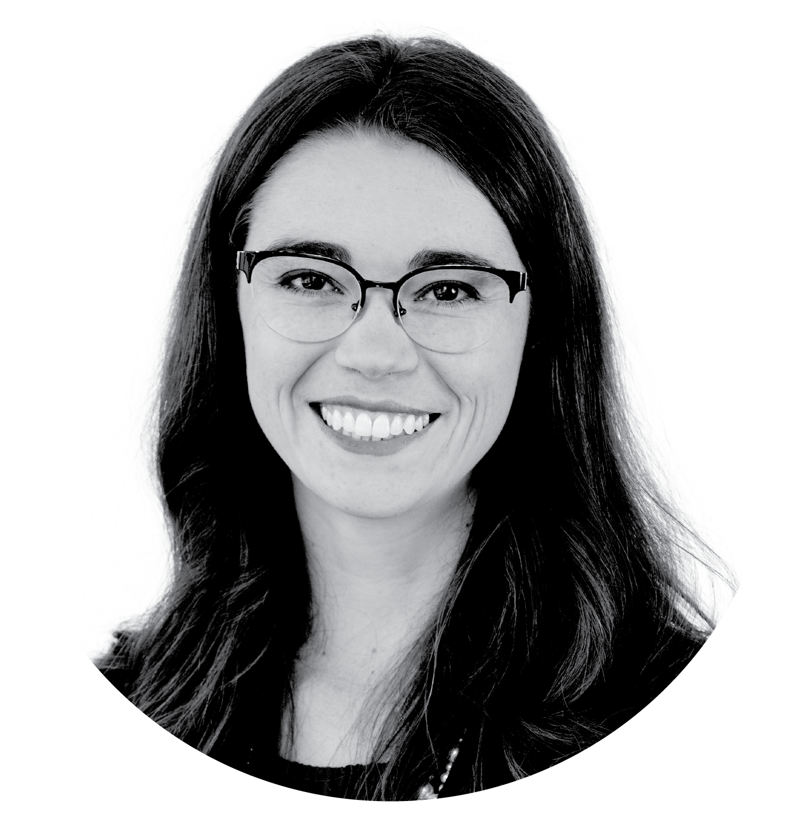

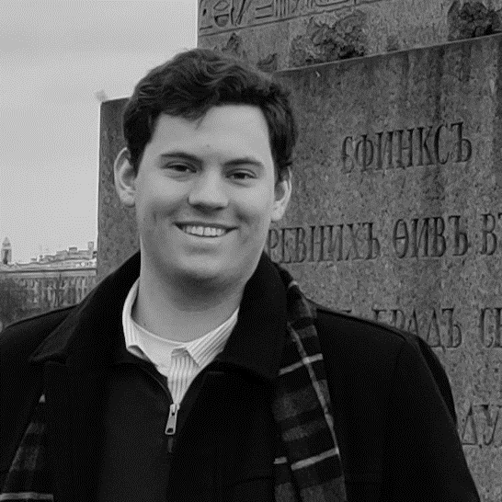

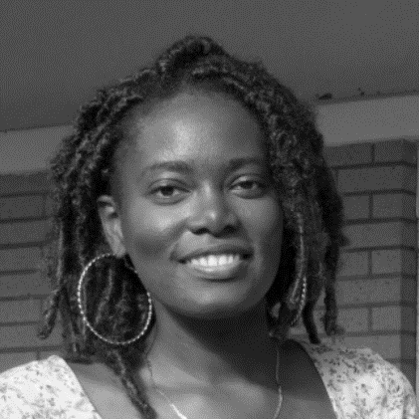







Our team
Alex Edquist, CEO
Former McKinsey and AI product owner
Kirsten Simmons, CPO
Farmer and data scientist
Joseph Hubbard
Tech Lead
Allen Osorio
Financial Lead
Reba Liddy
Marketing Lead
Georgia State House Ag Committee
Notes:
Helping farmers get more profitable is a gnarly problem, but we have the team to do it. I bring the business and product expertise from a career at McKinsey & Company, my cofounder Kirsten is both a farmer and a data scientist. The rest of our team brings a ton of experience in their functional area and the food & ag space.

Slide 9
Reaching just 4% of farmers is $216M in annual revenue
TAM: U.S. farms business management: $60.4B
Benchmarks show most organizations spend >10% of their revenue on their back offices; U.S. farm revenue is $604B.
We charge the average farmer $2400 annually; there are 2M farmers in the U.S.
U.S. farms financial management: $4.8B
TOTAL SAM: $5.4B
Farm funding: $550M
There is $11B annually in farm funding; we charge 5% of funding won
Our initial customer is a small-to-midsize (40% of farms), beginning (30% of farms) farm using at least one regenerative practice (30% of farms)¹
SOM: Beachhead customer (4% of market) financial management & funding: $216M
  1 Conservative estimate because beginning farmers are more likely to be smaller and use regenerative practices; any way we slice it, the market is enormous
  Sources: USDA ERS 2022; USDA Structure & Finances of U.S. Farms, 2014; McKinsey, Hubspot, and CFO Daily benchmarks

Slide 10
How we reach $100M in revenue by 2030
$113M
$45M
How we exceed $100M:
Scale existing funding & financial management business to tens of thousands of farmers
Launch sellable MVP of operational analysis tool in 2025
Expand upon financial management to offer payroll & bill pay in 2027
Use data to offer intelligent loan & insurance product recommendations starting in 2027 – and collect referral fees
$18M
$1M
$4M
$350k
Detailed financial model available to share upon request

Slide 11





… which are beneficial but time-consuming for farmers
Why now? Farms are being pushed to sustainable practices…
Captures
carbon
$23B
Builds topsoil
Hundreds of investors
$48B
Reduces
pollution
Improves biodiversity
Dozens of food brands and retailers
>75M acres
Is resilient to shocks
Produces healthier food products

Slide 12

Competitive landscape
Fully solves the farmer’s problem
Easy & affordable (NOT insightful)
Affordable & insightful (NOT easy)
Easy & insightful
(NOT affordable)
SMB pure-SaaS products (e.g., QuickBooks)
Farm-specific pure-SaaS products (e.g., Ambrook, FarmRaise)
Manual bookkeepers and consultants
Pen & paper
(status quo)
12

Slide 13
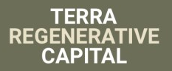




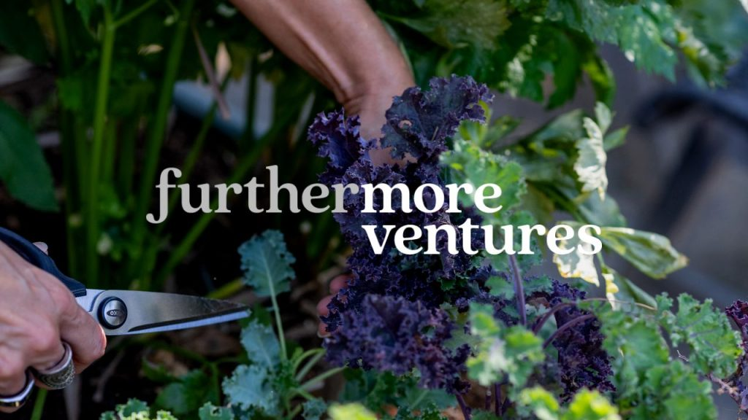
We’re looking to a seed round in Q2
We’re backed by:
Milestones before seed round:
150-200 customers
$100-200k ARR
Fully scalable tech product
Notes:
We just closed a $650k pre-seed round last week and are looking forward to a seed round next year, and we’d love to start building relationships with seed investors now so you can get to know us as we grow.

Slide 14


Why RevTech Labs
We’re ag & software experts… but not fintech/insurtech experts
We need help getting ahead of compliance requirements
We’d like to build towards integrations with ag lenders
Notes:
We’re transforming the agriculture industry, and we need bold partners to help us do that. Y’all are awesome supporters of female founders and have a long track record of building successful tech companies, but that’s really table stakes. But you also know agriculture, and you’re actually practitioners yourself, and you know sustainability, which is a rare combination. We’re building a world in which agriculture can be a profitable, sustainable, and rewarding profession, and we’d love to have HearstLab on that journey with us. Thank you.

Slide 15
Get in touch
Reach out to Alex:
alex@goodagriculture.com
https://calendly.com/alex-goodagriculture
404-433-8588
Check out our website:
https://goodagriculture.com

Slide 17
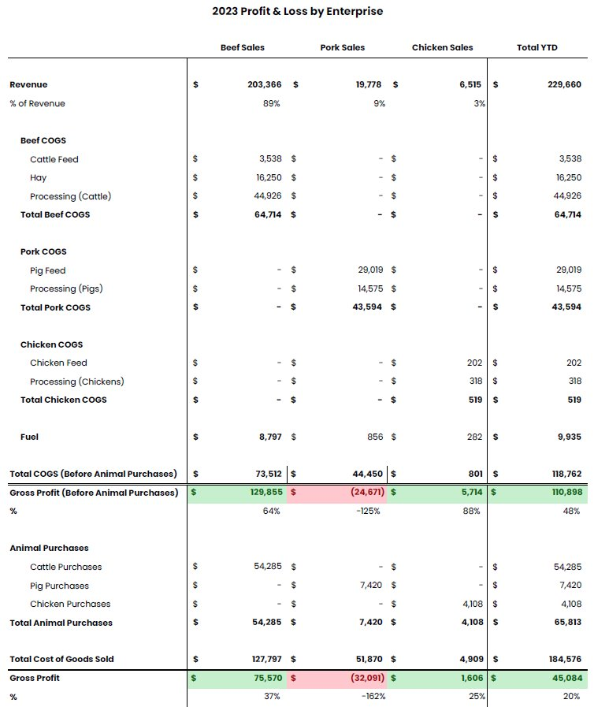
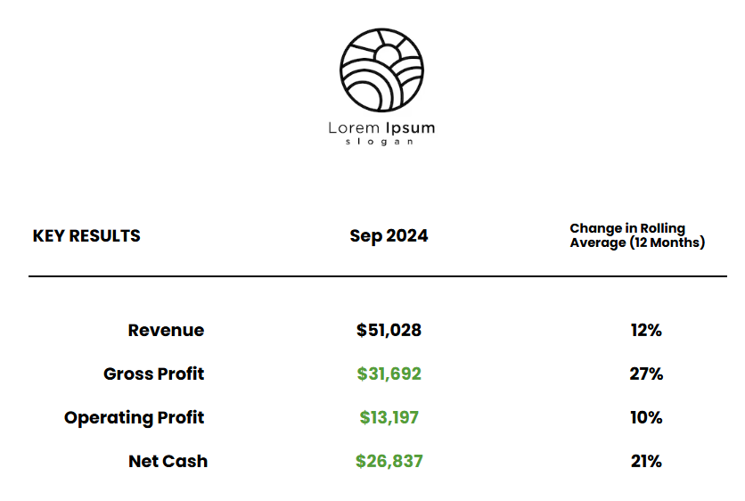
Financial management product: today

Slide 18
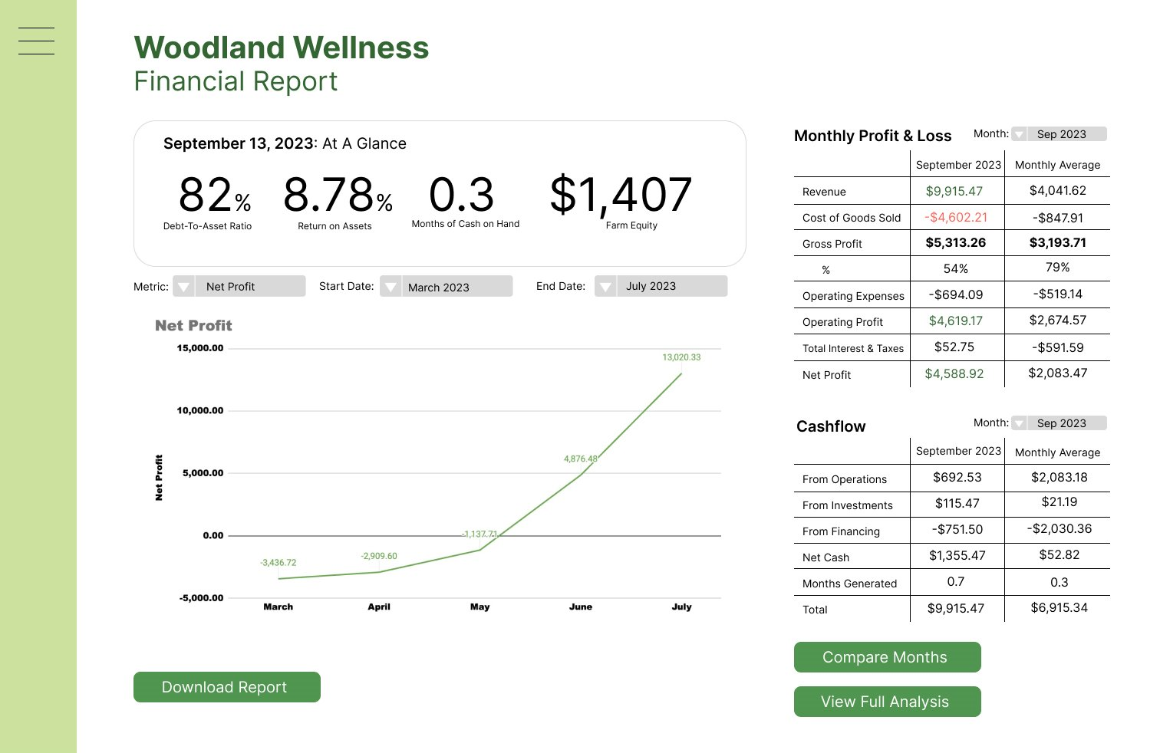
Financial management product: future
The Farm

Slide 19
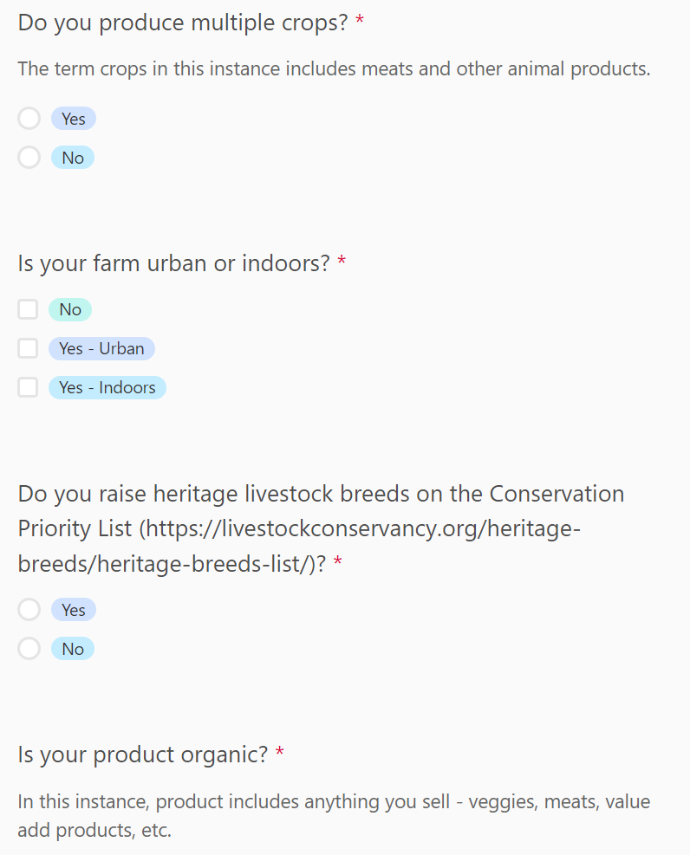
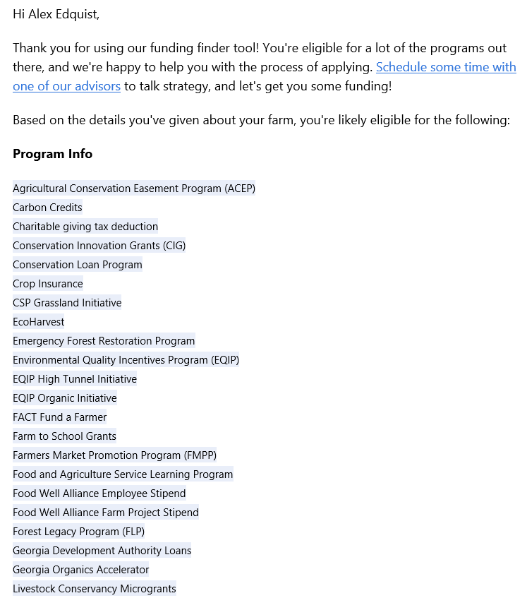
Funding product: today

Slide 20
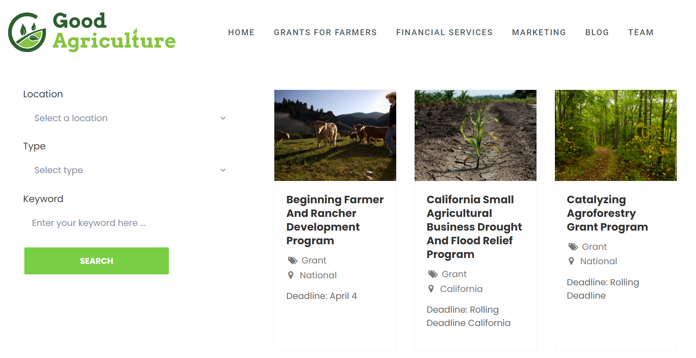
Funding product: future

Slide 21








Management-as-a-Service has a long track record of success in other industries
Restaurants
Beauty
Medical Practices
Acquired for $17B
IPO at $20B
2M customers, has made 6 acquisitions, acquired by PE
$88M Series C in 2019, $240 acquisition of Compeat in 2021
$1B valuation
$1B valuation
IPO, $1B valuation
$1B valuation
21

Slide 22
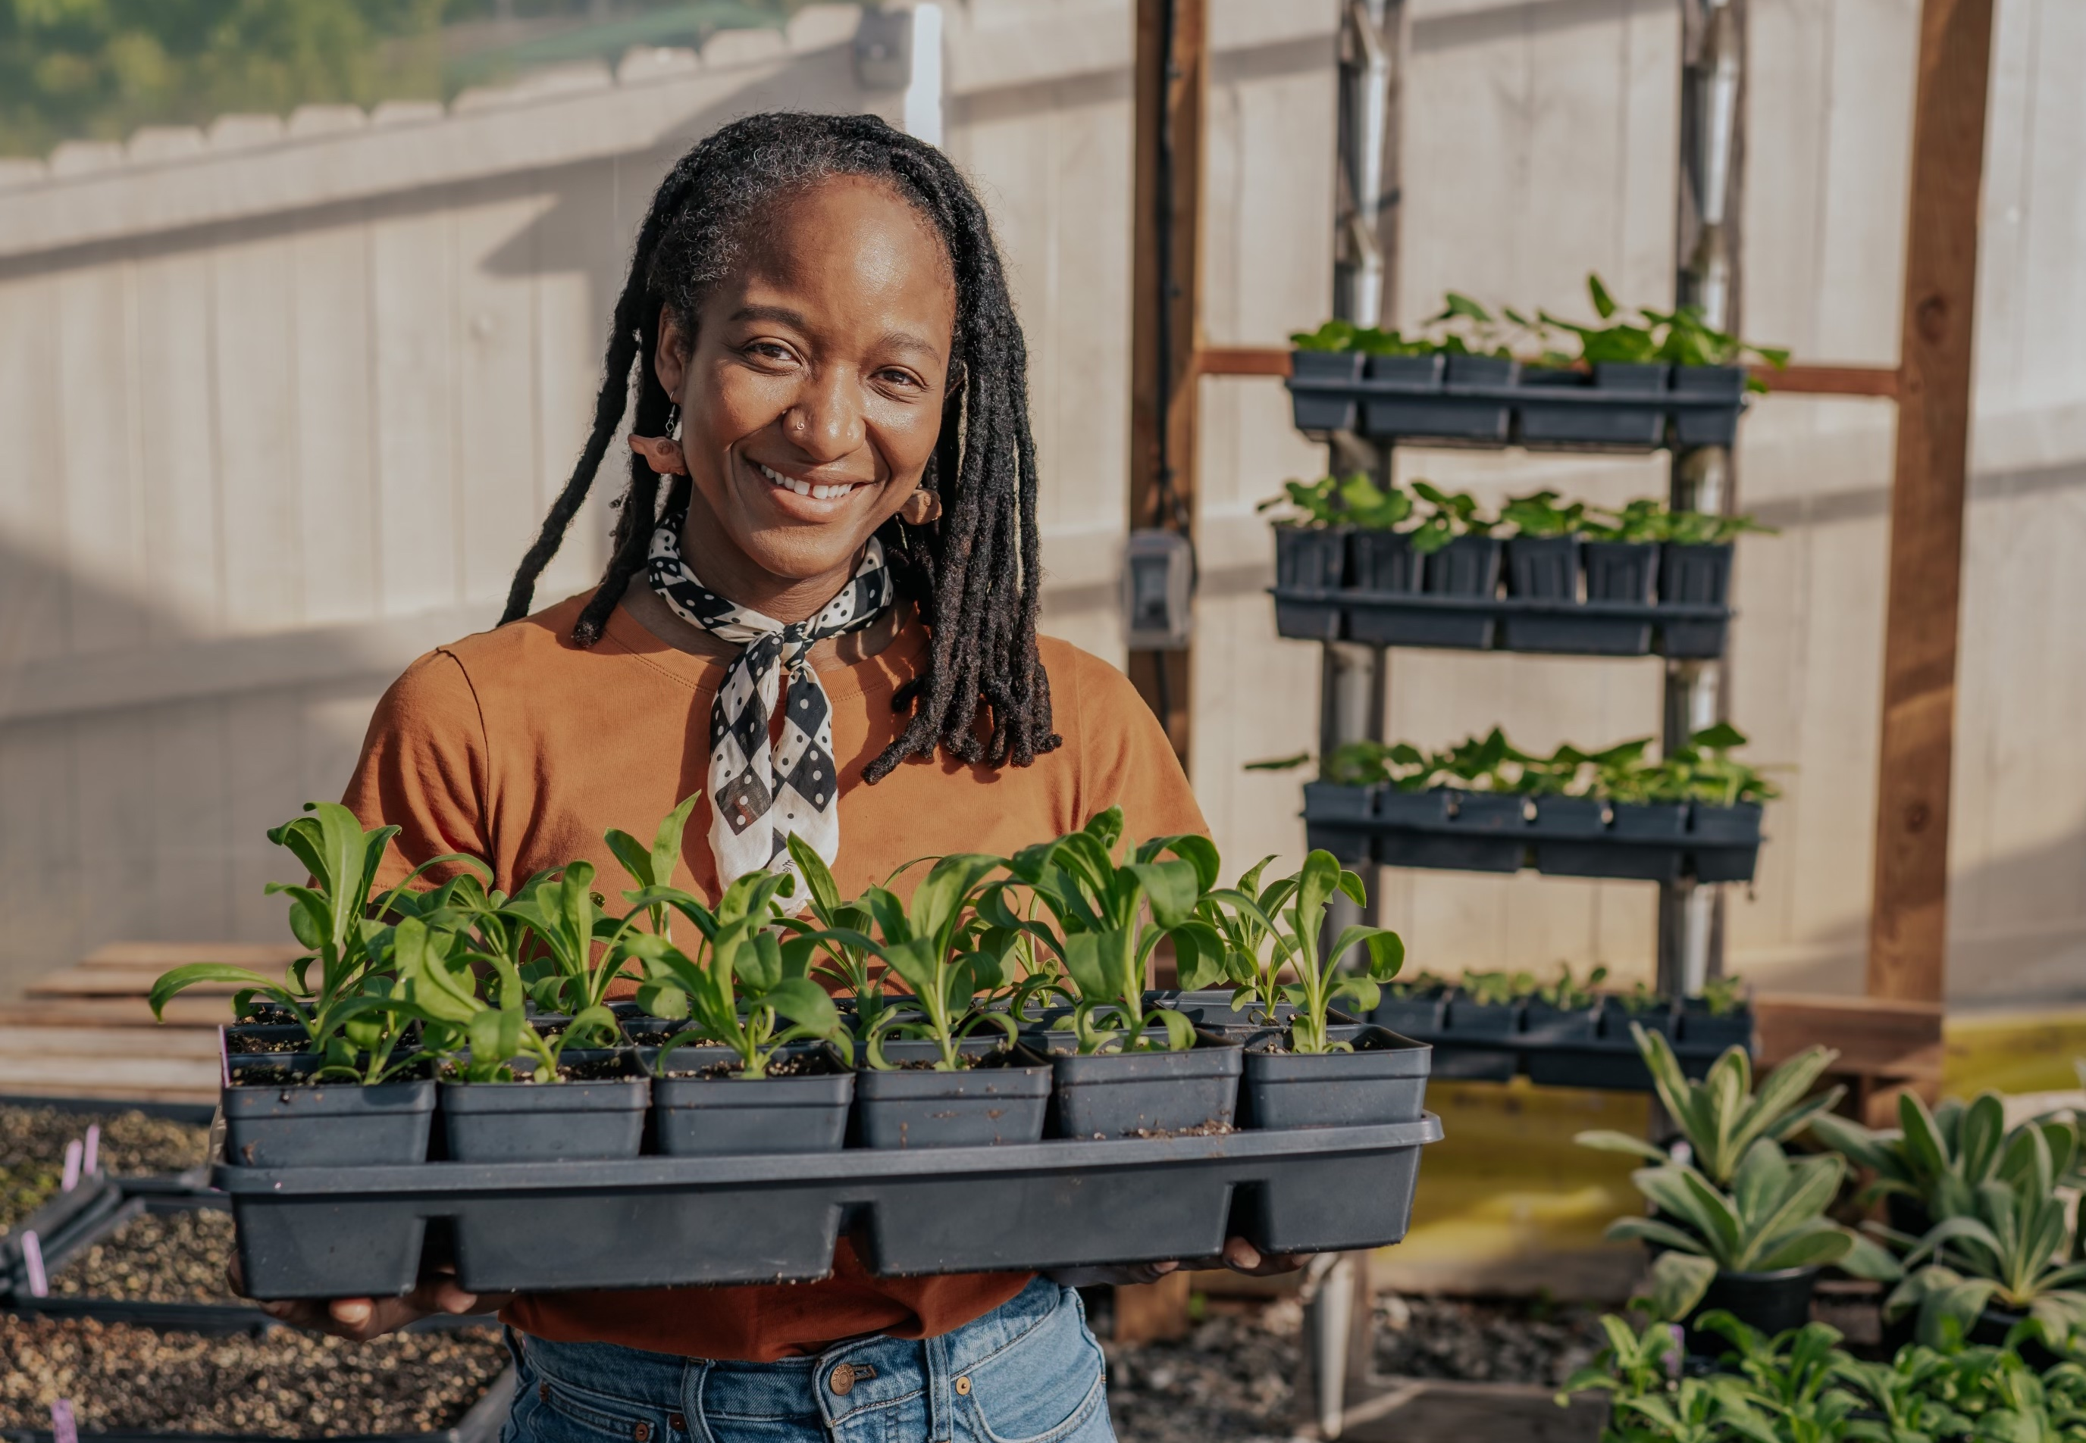
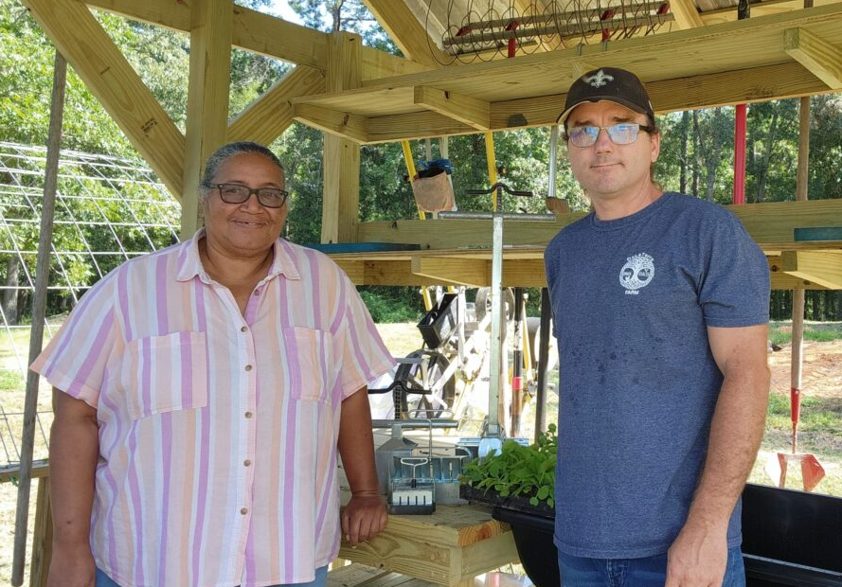

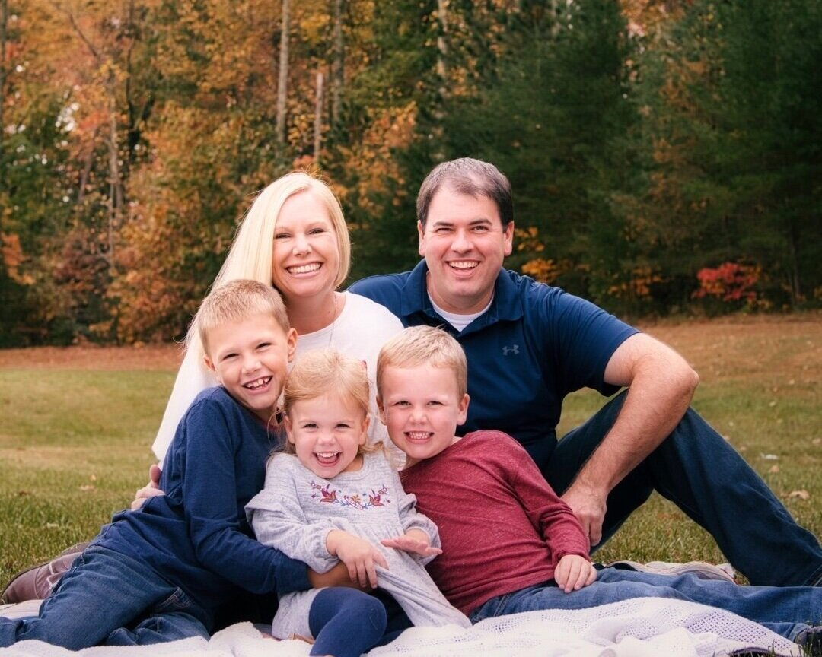


Testimonials
“There is no way I could have done this without Good Agriculture. They didn’t just reduce my stress – they made me so much more productive because I don’t have to do the parts they’re managing.”
Donna, DeLaTerre Permaculture Farm
“Good Agriculture saved me days in pulling my finances together. They brought a level of professionalism and insightfulness to my finances – now I can focus on growing the farm (and spending more time with my wife!)”
Steven, The Rural Urban Connection
"Good Agriculture has saved me lots of sleepless nights. Now I know exactly how much money is going into and out of the business and have a five-year plan for my farm.“
Patty, Bedhead Nursery
Notes:
I’d like to share a few of our customers’ stories. Donna from DeLaTerre Permaculture Farm is a good example of the type of farmer that Harvest Returns might refer to us. She’s an awesome farmer, really innovative, is on the NRCS Louisiana front page every other month, and she had the opportunity to expand her operation when the farm across the street came up for sale. She came to us totally hair on fire because she found a funder but wasn’t going to be able to pull her financials together in time. We helped her with her financials and a business case and she was able to get the funding to expand her farm. Steven from TRUC Farm is another one of our oldest customers. He’s transitioning his family’s farm from a conventional cattle and hay to a regenerative, rotational grazing operation selling grass-fed beef into the Atlanta market. We have been doing his financials for a year and helped him achieve profitability and double his revenue. We also helped him with a business case to expand his operation for this year. Patty from Bedhead Nursery is one of our beginning farmers. We helped her start off on the right foot last year, and 2024 looks like it’s going to be awesome for her. These folks are representative of our initial customer, who tend to be operationally complicated (farming regeneratively, growing lots of different things, have multiple enterprises), first generation/minority/beginning farmers, and small-to-midsize farmers. We do also sell to farmers who are conventional, multi-generational, and larger, but as you all know, there are enough farmers who loo like Donna, Steven, and Patty to keep us busy and growing fast for a long time!

