Slide 1

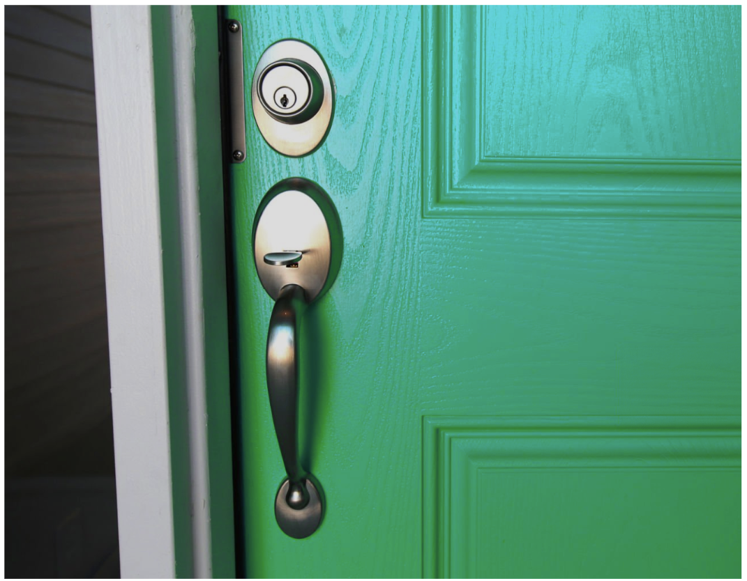
Better loans,
Brighter futures.
Halitra’s software empowers lenders to profitably finance energy efficiency upgrades.
Thor Jensen | Thor.Jensen@Halitra.com
Kamal Singh | Kamal.Singh@Halitra.com

Slide 2





Team
Kamal Singh | COO
Co-Founder
Technology evangelist and chief motivator. Decade of emerging tech sales experience in the built environment.
Dr. Thor Jensen, | CEO
Co-Founder
Postdoc explored failure of green banks, in accelerating cleantech adoption in buildings. 2X cleantech entrepreneur.
Viet Hoang | CIO
Full stack developer, expert in AI integrations. Double major in math and computer science graduate.
Dr. Hadi Dowlatabadi | CTO
Prev. Exec. Director largest climate and energy decision making unit in the world, Emeritus Professor UBC. 6X Cleantech entrepreneur,
Notes:
Let’s not include advisors – but I can mention that our advisor network includes hundreds of millions in clean technology finaincing

Slide 3
Problem
Finance home energy renovations

Slide 4

Solution
Finance home energy renovations
Top-up home renovation lending

Slide 5


Value Proposition
Local Energy Prices
Local Contractor Pricing
1M Buildings +15 Upgrades
Taxes & Permits
$ Cost
. $ Value .
$ Savings
MLS Realtor Listings
Green
Certified Properties
2-8% equity increase
Recognize Value
Recommend Upgrades
Halitra Knowledge Engine .
Notes:
https://www.btelligent.com/en/blog/reinforcement-learning-bayesian-statistics-part-1-1/
2% to 8% better resale value¹ 3-5% reliably
0.5% premium for every 1-point increase in Home Energy Score (HES)².
PJM MARKETS = evolving energy because of batteries
Inflation + GGRF = Incentives Change Pricing – we work with contractors on pricing sheets
Bayesian Updating → Machine Learning → AI Reinforcement Learning
Bayesian updating to modify prior datasets with each observation
We process over 500 building data variables and terabytes of public and private data sources.
Proprietary data modeling by building type and geography ensures you get the highest quality loan lead lists.
Halitra runs the reports, you become the energy efficiency expert.
We track actual energy performance post-loan therefore improving score accuracy.

Slide 6

Go-to-Market Strategy
Lenders have first touch on the single most valuable lead in the market for home energy upgrades.
Notes:
Sources: 1. FRED (link). 2. 2024 US Houzz & Home Study (link). 3. NAR (link). 4. HIRI (link). 5. LendingTree (link).

Slide 7
Go-to-Market Strategy
Home Renovation Lending
$452B in unused HELOCs
80% of new homebuyers renovate
1/3 Homeowners planning a renovation

Slide 8

Market Size & Competition
111.0b
331.0b
45.0b
Home Renovation¹
Energy Upgrades
HVAC + Hot Water
1. Harvard Joint Center for Housing Studies 2023

Slide 9




Market Size & Competition
111.0b
331.0b
45.0b
Home Renovation¹
Energy Upgrades
HVAC + Hot Water
Emergency Repair.
1. Harvard Joint Center for Housing Studies 2023
Notes:
https://home.treasury.gov/news/featured-stories/the-inflation-reduction-act-saving-american-households-money-while-reducing-climate-change-and-air-pollution

Slide 10







Market Size & Competition
111.0b
331.0b
45.0b
Home Renovation¹
Energy Upgrades
HVAC + Hot Water
Emergency Repair.
Direct B2C Sales.
1. Harvard Joint Center for Housing Studies 2023
Notes:
https://home.treasury.gov/news/featured-stories/the-inflation-reduction-act-saving-american-households-money-while-reducing-climate-change-and-air-pollution

Slide 11



Business Model + Financials
Marketing Fee
Success Fee

Slide 12

Business Model + Financials
Marketing Fee
Success Fee
105k
100bps
3 x Fixed Price Contracts
Variable Fee

Slide 13
Business Model + Financials
$500K ARR
$41K MRR
Marketing Fee
Success Fee
Q4 Target
105k
100bps
$105K ARR
8.75MRR
3 x Fixed Price Contracts
Variable Fee

Slide 14











Ask & Traction
    Raising $750K Q2 2025
    Runway to cashflow breakeven in Q4
    Form credit union service organization
    Match with six figures of non-dilutive $
Our RevTech Ask
    $120K - $25K Data + $50K Soc2 Type2
    Earn EIR trust for warm introductions
    EIR mentorship to deliver PoC w Citizens

