Slide 1
intelligent content
THE NEXT GENERATION CORPORATE DOCUMENT

Slide 2
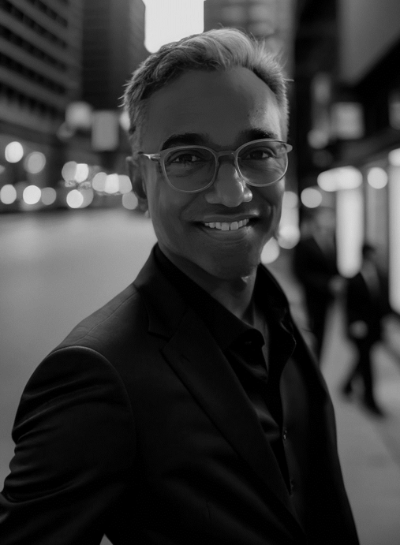
Romesh Jayawickrama
Founder, CEO
■
25 years in investment banking and
technology
■
2x Founder
■
Aurigin: largest private equity deal platform in the world within 3 years of launch

Slide 3
Leadership
Amrish Bharatiya
Justin Okita
Mark Munoz
CTO
VP - Sales/Growth
Advisor & Lead VC
CodeSignal

Slide 4
Problem
■
Corporate document formats 40 years old
Founded in 1983
Founded in 1987
Founded in 1993
■
The world has changed
■
Nobody reads long documents anymore

Slide 5
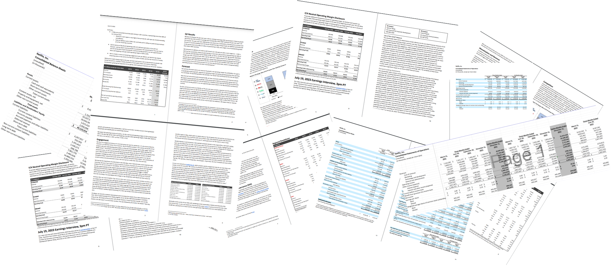
Instead Of Creating This

Slide 6
Create with

Slide 7
How Inttent Works
INPUT
INTTENT
OUTPUT
User uploads all their source files into the Inttent dashboard
AI agents retrieve content from 100's of source files
Fine-tuning models publish content in a multi-modal format

Slide 8
Value Proposition
■
Speeds up complex document creation:
(Example “Confidential Information Memorandum”)
- Average 400hrs to create
- Inttent reduces process to 2 hrs
200x faster
Increases consumption:
Multi-modal output aligns with content consumption
Increases engagement 3-5x
Granular analytics:
- Offers highly detailed analytics on audience behaviour
■
■

Slide 9
Market Size
TAM
$36 Billion
SAM
$28 Billion
SOM
$5 Billion
Source: McKinsey & Bain research reports 2019, # docs produced and average costs

Slide 10
Competition
Design Focused
Intelligence Focused

Slide 11
Revenue Model
STANDARD
PREMIUM
ENTERPRISE
$5k – 20k/yr
$60k – 100k/yr
$200k+/yr
Boutique Firms
Large Firms
Very Large Firms
■
Pricing dependent on levers:
No. of publication
No. of seats

Slide 12
Go-to-Market: Ecosystem-Led
■
Selling to the vertical we know well:
12,000
Boutique IBs
($200 Mn market)
Funds,
Acquirers
■
Channel Partner Aurigin:
60,000 relevant customers for inttent
12,000 advisories (boutique IBs)
Direct Corps

Slide 13
Traction
■
LOIs - $180k (+ $35k WL)
Design Partners
and Referrals
■
Premium - $80k
■
Total - $ 295k
“We are amazed by Inttent. All 1,800 companies listed on the LSE should be using it”
Partnership
discussions

Slide 14
Financial Stats
■
Funding : $1mn already raised
Gross Burn: $65k/mth
(expanded post recent investment)
Forecast : FY2024 FY2025 FY2026
$205k $1.2mn $3.6mn
Sales : Aug-Dec conversion of LOIs
■
■
■

Slide 15
Ask
■
Raising Seed
: USD 1.5 Million ($500k remaining)
■
Lead VC
: Vectr Fintech
■
Other VCs
: Blue Startups
: Hatcher+
■
Program Outcomes
: Help in closing final $500k
: Strategic partnerships
: Commercial partnerships
Founded in 2023
Founded in 1993
Founded in 1987
Founded in 1983

