Slide 1

Autopilot for accounts payable
Listra is the control layer that lets an AI agent run accounts payable and receivable safely. It investigates exceptions, decides under your policies, communicates with vendors, and posts to the ERP, within your thresholds, with a full audit trail on every action.
ACCELERATOR APPLICATION listra.ai

Slide 2




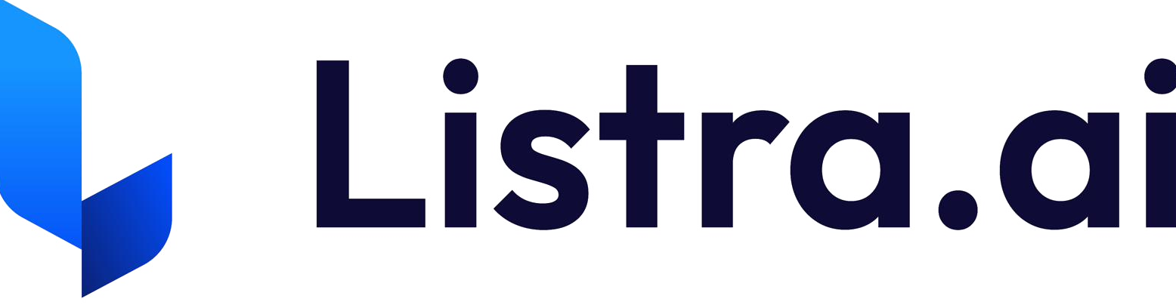
THE PROBLEM
AP teams spend most of their time on work the software won't do
Most AP systems digitize documents and route tasks. They leave the work that matters, researching discrepancies, validating receipts, answering vendors, and deciding, to people. Visibility improved. Execution did not.
What stays manual today
Research price and quantity discrepancies
~60%
of AP time goes to exception resolution
Chase approvals and answer vendor emails
400+ hrs
of manual exception work per month at 2,000 invoices
Verify receipts and prevent duplicate payments
Every entity
adds load: more vendors, locations, and exceptions compound
Assemble audit evidence for every case
02

Slide 3



WHY NOW
Three shifts make AP autopilot possible now
Machines can read finance
Systems are connected
Leaders want execution
LLMs interpret invoices, contracts, and vendor emails as unstructured text. No rigid templates required.
ERPs, procurement, warehouse systems, and bank feeds now expose the data needed to reason across systems.
Fraud risk, labor constraints, and approval bottlenecks shifted demand from better workflows to real operating automation.
Capability, data access, and market readiness converge for the first time. The window is open now.
03

Slide 4






WHAT WE BUILT
One closed loop runs on every invoice
Listra is the control layer, not a workflow tool. It assumes system-led resolution by default and pulls a human in only when policy requires it.
1
2
3
4
Observe
Ingest
Reason
Resolve
Monitor inboxes, ERPs, and vendor channels for events that need action
Capture invoices from any source and pull POs, GRs, and contracts
Interpret pricing, terms, and tolerances across systems, not templates
Determine the fix and, when allowed, execute corrections and short-pays
5
6
7
Communicate
Finalize
Protect
Draft and send vendor messages when clarification is needed
Post cleanly to the ERP as the single source of truth
Catch duplicates and fraud, with every action fully auditable
If a step requires manual research by default, autopilot has not been achieved.
04

Slide 5
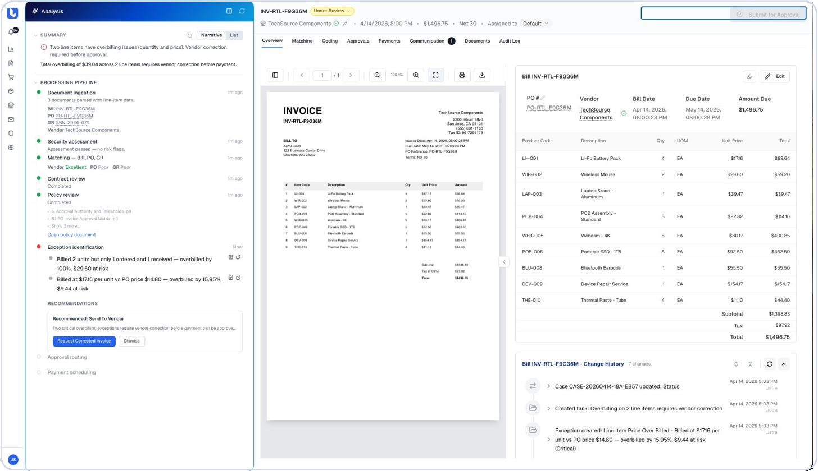


SEE IT WORK
One hard case, start to finish
The closed loop, running on one real overbilling invoice.
Caught the exception
Two line items overbilled on price and quantity, flagged before approval
Quantified the risk
$39.04 at risk across the two lines, quantified to the dollar
Checked against everything
Bill matched to PO, goods receipt, contract, and policy, with page references
Recommended the fix
Drafted a vendor correction request, with a full audit trail behind it
No analyst touched it until there was a real judgment call.
05

Slide 6


WHY IT'S DIFFERENT
Two agents that ground every decision in your documents
Listra reasons from your own policy and contracts, not generic rules. That grounding is the moat, and it compounds with every document and resolution.
Policy Agent
PROVISIONAL PATENT
Contract Analysis Agent
Plain-language AP policy becomes versioned, testable rules
Gap analysis flags where workflows diverge from policy, to the exact page
One-click fix generates the corrected configuration
Vendor contracts parsed into rate cards, price tolerances, and payment terms
Grounds matching and exception decisions in the negotiated terms
Catches pricing mismatches against the contract, not a guess
Every policy, contract, and resolution compounds per account. Replacing Listra means re-encoding all of it.
05

Slide 7


DIFFERENT AND BETTER
Workflow routers vs. a control layer
Workflow routers (incumbents)
Listra control layer
Static rules and linear approval chains
System-led resolution by default
Human-led exception investigation
Reasons across ERP, procurement, and email
Humans are the default decision-maker
Drafts and sends vendor communication, posts to the ERP
AI bolted onto a workflow built for routing
Humans supervise outcomes, not execute the work
Autopilot needs the opposite architecture. Incumbents can only reach it by rewriting their platform and undermining their installed base. That gap is structural, not a feature list.
06

Slide 8
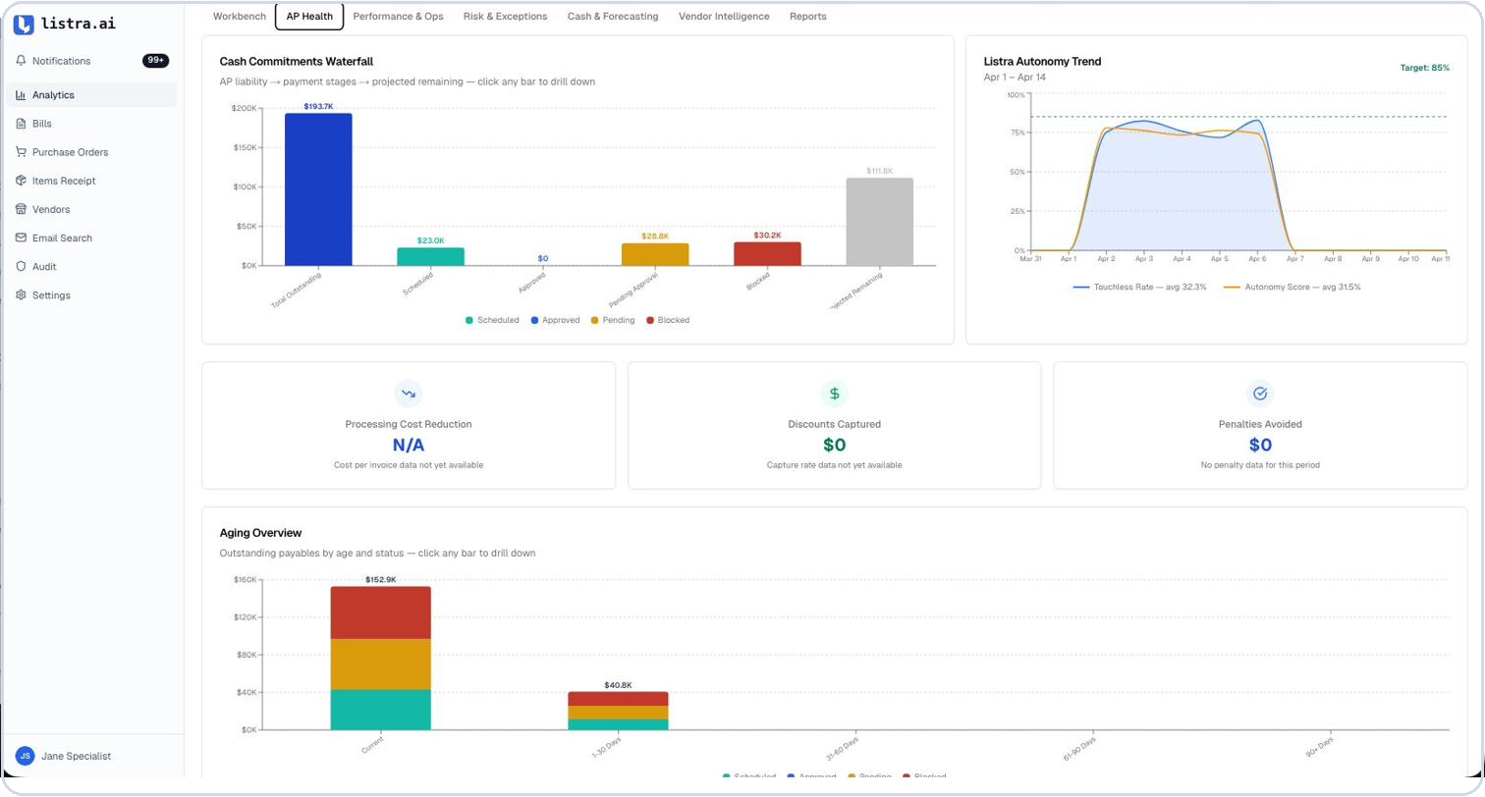




IT'S REAL AND SHIPPED
In production, doing the hard cases first
20+ automated validation controls on every bill
AI multi-way matching: invoice to PO, goods receipt, and contract
Vendor communication sent from the case view
Bidirectional ERP sync
Analytics dashboards for AP leaders
AP Health, live in the product
Immutable audit trail with downloadable evidence packs
Fraud and duplicate payment prevention
Sender and typosquatting checks, amount anomaly thresholds, a duplicate detection window, and bank-change blocks.
ENTERPRISE-GRADE CASA Tier 2 · SOX-ready · RBAC · WAF · AWS
07

Slide 9



THE ADOPTION MODEL
Copilot earns the trust that Autopilot runs on
Copilot
Autopilot
Prepares evidence, drafts vendor messages, classifies issues, and recommends actions. A human approves each one.
Executes end to end within configured thresholds. Cases outside the thresholds escalate to the right reviewer automatically.
Every intervention becomes labeled training data.
Trust grows, thresholds widen, more work disappears.
We build for the hardest exceptions first. If the engine handles contract pricing mismatches and multi-PO splits, routine invoices are trivial. Workflow automation cannot evolve the other way.
08

Slide 10




TRACTION
Four paying customers in our first 10 weeks
10 weeks
4
AP live
2 ERPs
Live in market since March 2026
Paying customers
AR in beta on the same loop
NetSuite and QuickBooks Online
Four paying customers, and a pipeline building behind them
1 live in production
1 in implementation
2 queued to onboard
12+ in active sales cycles
Customers and pipeline span med-legal, utilities, behavioral health, manufacturing, and technology services.
09

Slide 11
THE TEAM
Operators who have built & sold finance software before
AA
Andrew Anton
TL
Taylor Lilley
CEO & CO-FOUNDER
CTO & CO-FOUNDER
~15 years enterprise finance software: Oracle, Celonis, Trintech, Exigo
Wharton MBA
IOFM Certified Procure to Pay Practitioner, the highest-level AP and procurement certification
Architect and CTO of a payments platform acquired by Banc of California
Leads platform architecture and the AI control layer
10

Slide 12
THE LONG-TERM VISION
The operating layer between finance policy and the systems of record
AP is the entry point: the densest operational node in finance, where the manual burden is highest and the ROI is immediate. The same closed loop extends to AR, vendor management, reconciliation, and cash.
AP today
AR in beta with paying customers
Reconciliation and cash next
Finance teams move from processing transactions to managing risk. Listra executes the repeatable work.
listra.ai

